Slide 1

Bikes and Restaurants in Miami
By William finch

Slide 2
Have you ever thought to yourself: “I want to open a restaurant, but will it be popular?” (firstly terrible idea, the hospitality industry is notoriously difficult to be successful in.)

Slide 3
Well lets have a look, at Miami and the bike stations there
Why did we choose miami? Because it had a beautiful 170 results for bike stations and was an easy number to work with.

Slide 4
First we grabbed information from Citi Bikes, Yay, easy to use and all worked well.

Slide 5
We took those bike locations and went to Foursquare and Yelp to see what was around
Foursquare didn’t give us much, so we stuck with yelp

Slide 6

We also built a beautiful database of all the different information we had gathered.

Slide 7
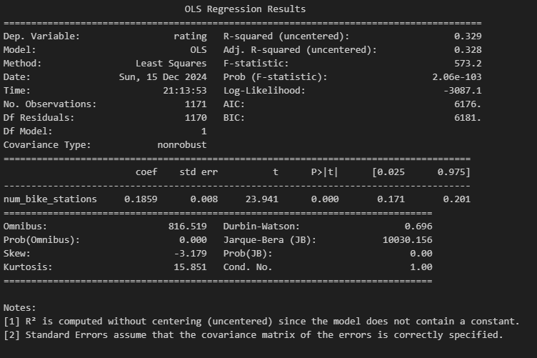
Finally we counted all the bike stations near each restaurant and ran a regression model on them

Slide 8
Wonderful! We might say we have solved restaurants! Simply put up 27 bike stations with 500m of your restaurant and you are GUARENTEED a 5* rating.
sadly we all know this isn't true and a more accurate way of looking at this model would be understanding the busier areas (that have more bike stations) are going to be more popular for the better restaurants.

